Slide 1
Computational Physics
(Lecture 6)
PHY4061

Slide 2
Steepest descent method
In the sample program above, the search process is forced to move along the
direction of descending the function g(x) when looking for a minimum.
x_{k+1} = x_{k} + Δx_{k} , the increment Δx_{k} has the sign opposite to g’(x_{k} ).
An update scheme can be formulated as
X_{k+1} = x_{k} + Δx_{k} = x_{k} − ag’(x_{k} ),
a is a positive, small, and adjustable parameter.

Slide 3
In a multivariable case
X_{k+1} = x_{k} + Δx_{k} = x_{k} − a∇g(x_{k} )/|∇g(x_{k} )|,
where x = (x1, x2, . . . , x_{l} ) and ∇g(x) = (∂g/∂x1, ∂g/∂x2, . . . , ∂g/∂xl ).
Note that step x_{k} here is scaled by |∇g(x_{k} )| and is forced to move toward the
direction of the steepest descent. => steepest descent method.
One example: an implementation of such a scheme to
search for the minimum of the function g(x, y) = (x − 1) ² exp(−y²) + y(y + 2) exp(−2x²) around x = 0.1 and y = −1.
For any arbitrary physical problem, how do we choose the starting point for the search?

Slide 4
// An example of searching for a minimum of a multivariable
// function through the steepest-descent method.
import java.lang.*;
public class Minimum {
public static void main(String argv[]) {
double del = 1e-6, a = 0.1;
double x[] = new double[2];
x[0] = 0.1;
x[1] = -1;
steepestDescent(x, a, del);
System.out.println("The minimum is at"
+ " x= " + x[0] +", y= " +x[1]);
}
// Method to carry out the steepest-descent search.
public static void steepestDescent(double x[],
double a, double del) {
int n = x.length;
double h = 1e-6;
double g0 = g(x);
double fi[] = new double[n];
fi = f(x, h);
double dg = 0;
for (int i=0; i<n; ++i) dg += fi[i]*fi[i];
dg = Math.sqrt(dg);
double b = a/dg;
while (dg > del) {
for (int i=0; i<n; ++i) x[i] -= b*fi[i];
h /= 2;
fi = f(x, h);
dg = 0;
for (int i=0; i<n; ++i) dg += fi[i]*fi[i];
dg = Math.sqrt(dg);
b = a/dg;
double g1 = g(x);
if (g1 > g0) a /= 2;
else g0 = g1;
}
}

Slide 5
// Method to provide the gradient of g(x).
public static double[] f(double x[], double h) {
int n = x.length;
double z[] = new double[n];
double y[] = (double[]) x.clone();
double g0 = g(x);
for (int i=0; i<n; ++i) {
y[i] += h;
z[i] = (g(y)-g0)/h;
}
return z;
}
// Method to provide function g(x).
public static double g(double x[]) {
return (x[0]-1)*(x[0]-1)*Math.exp(-x[1]*x[1])
+x[1]*(x[1]+2)*Math.exp(-2*x[0]*x[0]);
}
}

Slide 6
Note that the spacing in the two-point formula for the derivative is reduced by a factor of 2 after each search, so is the step size in case of overshooting.
After running the program, the minimum is at x =0.107 355 and y =−1.223 376.
simple but not very efficient scheme.
It converges to a local minimum near the starting point.
The search for a global minimum or maximum of a multivariable function is a nontrivial task, especially when the function contains a significant number of local minima or maxima. More will be covered later.

Slide 7
Matrix Operation

Slide 8
Matrix Operations
Matrix operations
  involved in many numerical and analytical scientific problems.
Schemes developed for the matrix problems can be applied to the related problems encountered in ordinary and partial differential equations. What problems in ODE and PDE can be solved by matrix operations?

Slide 9
  For example, an eigenvalue problem given in the form of a partial differential equation can be rewritten as a matrix problem.
  A boundary-value problem after discretization is essentially a linear algebra problem.

Slide 10
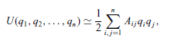
Vibrational spectrum:
  N degrees of freedom
  The harmonic oscillations of the system
  Expanding the potential energy up to the second order of the generalized coordinates around the equilibrium
  The potential energy:
  qi are the generalized coordinates and Ai j are the elements of the generalized elastic constant matrix

Slide 11
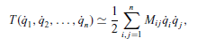
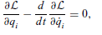
One simple example
the kinetic energy of the system:
q_{i} = dq_{i} /dt are the generalized velocities,
M_{ij} are the elements of the generalized mass matrix whose values depend upon the specifics of the molecule.
Apply the Lagrange equation:

Slide 12
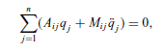
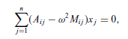
L= T-U is the lagrangian of the system.
If we assume that the time dependence of the generalized coordinates is oscillatory with
  q_{j}= x_{j} e ^{−iωt} , we have:

Slide 13

In matrix form:
Or Ax=λMx, where λ is the eigenvalue, x is the eigenvector.
The determinant of the coefficient has to vanish: |A-λM|=0

Slide 14
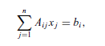

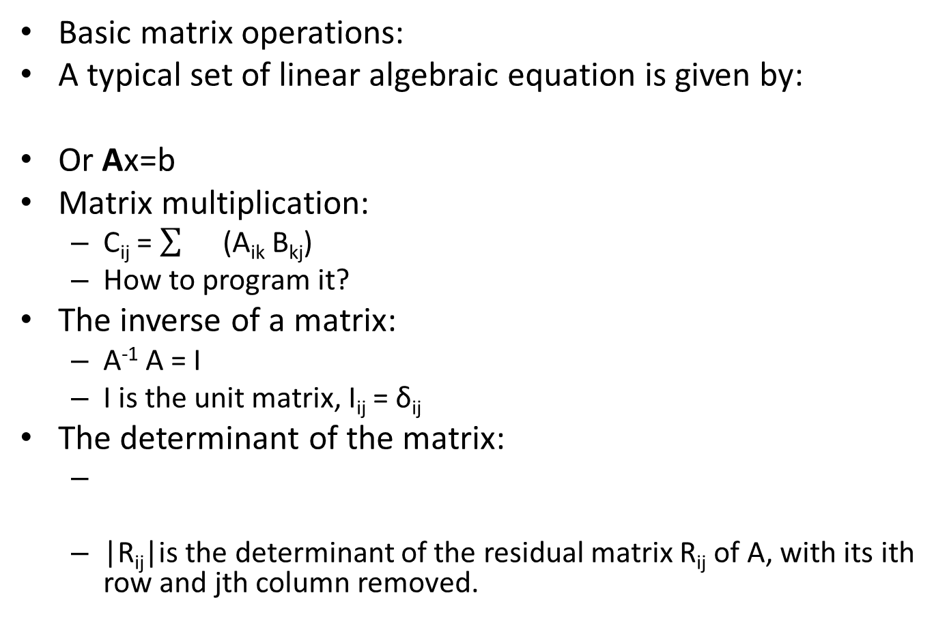
Basic matrix operations:
A typical set of linear algebraic equation is given by:
Or Ax=b
Matrix multiplication:
  C_{ij} = (A_{ik} B_{kj})
  How to program it?
The inverse of a matrix:
  A⁻¹ A = I
  I is the unit matrix, I_{ij} = δ_{ij}
The determinant of the matrix:
  |R_{ij}|is the determinant of the residual matrix R_{ij} of A, with its ith row and jth column removed.

Slide 15
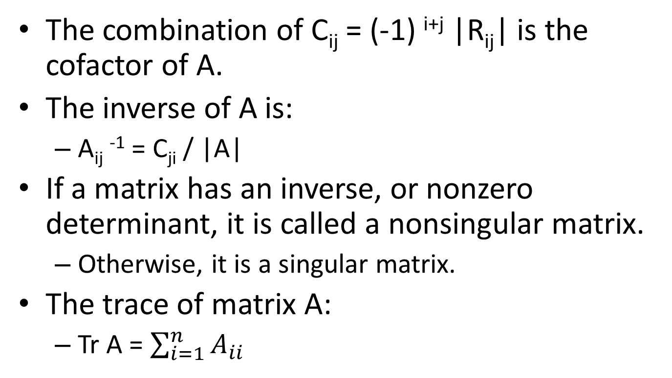
The combination of C_{ij} = (-1) ^{i+j} |R_{ij}| is the cofactor of A.
The inverse of A is:
  A_{ij} ⁻¹ = C_{ji} / |A|
If a matrix has an inverse, or nonzero determinant, it is called a nonsingular matrix.
  Otherwise, it is a singular matrix.
The trace of matrix A:
  Tr A = $\sum_{i=1}^{n}{A_{ii}}$

Slide 16
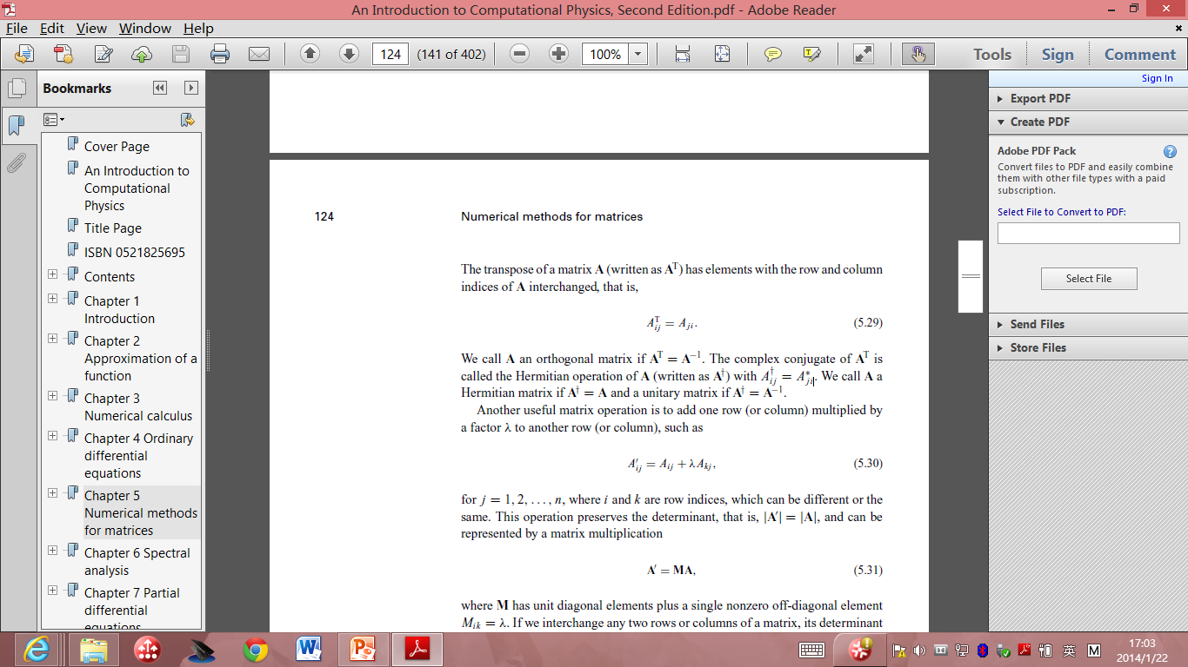

The transpose of a matrix: A^{T} has the elements with the row and column indices of A interchanged.
  A_{ij}^{T}= A_{ji}
  A is orthogonal if A^{T} = A⁻¹
The complex conjugate of A^{T} is called the Hermitian operation of A.
: Hermitian matrix
: unitary matrix.

Slide 17
Eigen value problem:
  Ax = λx
  x : eigen vector, λ: eigen value.
  One way to solve it is to use recursion:
    A x^{k+1} = λ ^{k}x^{k}
    Here λ^{k} and x^{k} are the approximate eigenvalue and eigenvector at the kth iteration. Iteration method.

Slide 18
Linear Equating Problem
Upper-triangular (lower-triangular) matrix
  the elements below (above) the diagonal are all zero.
  The simplest scheme for solving matrix problems ( Gaussian elimination)
  basic matrix operations to transform the coefficient matrix into an upper (lower) triangular first
  finds the solution by backward (forward) substitutions.

Slide 19
The basic idea of Gaussian elimination
  transform the original linear equation set to one that has an upper-triangular or lower-triangular coefficient matrix with the same solution.
The final linear equation set:
  A^{(n−1)}x = b^{(n−1)}, with A^{(n−1)} _{ij} =0 for i > j.

Slide 20
Procedure
multiply the first equation by −A(0)_{i1} /A(0) ₁₁ , that is, all the elements of the first row in the coefficient matrix and b(0) ₁ , and then add it to the ith equation for i > 1.
The first element of every row except the first row in the coefficient matrix is then eliminated.
Repeat the procedure from row 2….
What potential problems of this algorithm?

Slide 21
One Concern
The scheme fails if any of the diagonal elements are zero…
Interchange rows or columns to have the elements for divisions being as large as possible.
So called pivoting procedure.
Partial pivoting:
  Search for the pivoting element only from the remaining elements of the given column.
  Good compromise of computing speed and accuracy.

Slide 22
We don’t have to interchange the row in the program
  Because it is inefficient.
  How do you propose an algorithm to solve this problem?

Slide 23
// Method to carry out the partial-pivoting Gaussian
// elimination. Here index[] stores pivoting order.
public static void gaussian(double a[][],
int index[]) {
int n = index.length;
double c[] = new double[n];
// Initialize the index
for (int i=0; i<n; ++i) index[i] = i;
// Find the rescaling factors, one from each row
for (int i=0; i<n; ++i) {
double c1 = 0;
for (int j=0; j<n; ++j) {
double c0 = Math.abs(a[i][j]);
if (c0 > c1) c1 = c0;
}
c[i] = c1;
}
// Search for the pivoting element from each column
int k = 0;
for (int j=0; j<n-1; ++j) {
double pi1 = 0;
for (int i=j; i<n; ++i) {
double pi0 = Math.abs(a[index[i]][j]);
pi0 /= c[index[i]];
if (pi0 > pi1) {
pi1 = pi0;
k = i;
}
}

Slide 24
// Interchange rows according to the pivoting order
int itmp = index[j];
index[j] = index[k];
index[k] = itmp;
for (int i=j+1; i<n; ++i) {
double pj = a[index[i]][j]/a[index[j]][j];
// Record pivoting ratios below the diagonal
a[index[i]][j] = pj;
// Modify other elements accordingly
for (int l=j+1; l<n; ++l)
a[index[i]][l] -= pj*a[index[j]][l];
}
}
}
The above method destroys the original matrix. If we want to preserve it, we can
just duplicate it

Slide 25
Determinant of a matrix
The determinant of the original matrix can easily be obtained after we have transformed it into an upper-triangular matrix through Gaussian elimination.
the procedure used in the partial-pivoting Gaussian elimination does not change the value of the determinant only its sign
  can be fixed with the knowledge of the order of pivoting elements.
For an uppertriangular matrix, the determinant is given by the product of all its diagonal elements.

Slide 26
// Method to evaluate the determinant of a matrix.
public static double det(double a[][]) {
int n = a.length;
int index[] = new int[n];
// Transform the matrix into an upper triangle
gaussian(a, index);
// Take the product of the diagonal elements
double d = 1;
for (int i=0; i<n; ++i) d = d*a[index[i]][i];
// Find the sign of the determinant
int sgn = 1;
for (int i=0; i<n; ++i) {
if (i != index[i]) {
sgn = -sgn;
int j = index[i];
index[i] = index[j];
index[j] = j;
}
}
return sgn*d;
}
public static void gaussian(double a[][],
int index[]) {...}
}
// An example of evaluating the determinant of a matrix
// via the partial-pivoting Gaussian elimination.
import java.lang.*;
public class Det {
public static void main(String argv[]) {
double a[][]= {{ 1, -3, 2, -1, -2},
{-2, 2, -1, 2, 3},
{ 3, -3, -2, 1, -1},
{ 1, -2, 1, -3, 2},
{-3, -1, 2, 1, -3}};
double d = det(a);
System.out.println("The determinant is: " + d);
}
// Method to evaluate the determinant of a matrix.
public static double det(double a[][]) {
int n = a.length;
int index[] = new int[n];

Slide 27
solve a linear equation set after transforming its coefficient matrix into an upper-triangular matrix through Gaussian elimination.
The solution is then obtained through backward substitutions.

Slide 28
Interatomic potential of Ionic crystals
Reference book chapter to read: Interatomic Potential Models for Ionic Materials, by Julian D. Gale, Handbook of Materials Modeling, pp 479-497.

Slide 29
Ionic materials:
in many key technological applications
  solid state batteries
  fuel cells,
  nuclear waste immobilization
  industrial heterogeneous catalysis
A long history of computer simulation of their structure and properties
  to understand the materials science of these systems at the atomic level.

Slide 30
A binary compound is composed of two elements with very different electronegativities,
  as is the case for oxides and halides in particular,
  then it is convenient to regard it as being an ionic solid.
A result of charge transfer
  from one element to the other,
the dominant binding force between particles is the Coulombic attraction between opposite charges.
Close-packed, dense structures that show no strong directionality in the bonding.

Slide 31
Imagining an ionic solid as being composed of cations and anions
Coulombic attraction between ions of opposite charge, with a corresponding repulsive force between those of like nature.
Because ions are arranged such that the closest neighbours are of opposite sign, this gives rise to a strong net attractive energy that will tend to contract the solid in order to lower the energy.

Slide 32
There must be a counterbalancing repulsive force.
This arises from the overlap of the electron densities of two ions, regardless of the sign of their charge, and has its origin in the Pauli repulsion between electrons.
Hence, we can write the breakdown of the two-body energy in general terms as:
U_{ij} = U_{Coulomb ij} + U_{repulsive ij}

Slide 33
U_{Coulomb ij} = q_{i}q_{j} /4πε₀r_{ij}
The electrostatic energy is actually the most difficult to evaluate.
Easy to write down that the electrostatic energy
  the sum over all pairwise interactions, including all periodic images of the unit cell,
the complication arises because the sum must be truncated for actual computation!
  Truncation problem.

Slide 34
Unfortunately, the summation is an example of a conditionally convergent series, i.e., the value of the sum depends on how the truncation is made.
The reason for this can be understood by considering the interactions of a single ion with all other ions within a given radius, r.
The convergence of the energy of interaction, U_{r tot}, is given by the number of interactions, N_{r}, multiplied by the magnitude of the interaction, U_{r}: U_{r tot} = Σ_{r} N_{r}U_{r}
One Question: Which goes up fast in ionic potential and why?

Slide 35
As r increases, the number of interactions rises in proportion to the surface area of the cut-off sphere: N_{r} ∝ 4πr ² .
However, the interaction itself only decreases as the inverse power of r
Consequently, the magnitude of interaction potentially increases as the cut-off radius is extended.
The fact that the magnitude converges in practice relies on the fact that there is cancelation between interactions with cations and anions.

Slide 36
It turns out that the electrostatic energy of a system actually depends on the macroscopic state of a crystal due to the long-ranged effect of Coulomb fields.
It is not purely a property of the bulk crystal, but also depends, in general, on the nature of the surfaces and of the crystal morphology.
To make it feasible to define an electrostatic energy that is useful for the simulation of ionic materials, it is conventional to impose two conditions on the Coulomb summation:

Slide 37
The sum of the charges within the system must be equal to zero
The total dipole moment of the system in all directions must also be equal to zero
If these conditions are satisfied, the electrostatic energy will always converge to the same value as the cut-off radius is incremented.

Slide 38
There is also the issue of how rapidly the sum converges,
  since it is required that the calculation be fast for numerical evaluation.
By far the dominant approach to evaluating the electrostatic energy is through the use of the summation method due to Ewald
  which aims to accelerate the convergence by partially transforming the expression into reciprocal space.
The details of the derivation can be found in Kittel’s textbook on solid state physics.
Here I just listed the basic idea of Ewald summation.
  Do not worry, I do not require you to implement Eward summation.

Slide 39
In Ewald’s approach, a Gaussian charge distribution of equal magnitude, but opposite sign, is placed at the position of every ion in the crystal.
Because the charges cancel, all but for the contribution from the differing shape of the distribution,
the resulting electrostatic interaction between ions is now rapidly convergent when summed out in real space and converges to the energy U_{real}.
In order to recover the original electrostatic energy it is then necessary to compute two further terms.

Slide 40
Firstly, the interaction of the Gaussian charge distributions with each other must be subtracted.
Because of the smooth nature of the electrostatic potential arising from such a distribution, it is possible to efficiently evaluate this term, Urecip, by expanding the charge density in plane waves with the periodicity of the reciprocal lattice.
Again, the energy contribution is rapidly convergent with respect to the cut-off radius within reciprocal space.
Finally, there is the self-energy, Uself, that arises from the interaction of the Gaussian with itself.

Slide 41
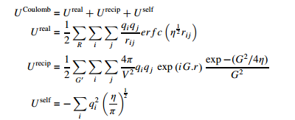
Mathematically, the Ewald sum is derived by a Laplace transform of the Coulomb energy and the final expressions are given below;

Slide 42
where R denotes a real space lattice vector, G represents a reciprocal lattice vector and η is a parameter that determines the width of the Gaussian charge distribution.
Note that the summation over reciprocal lattice vectors excludes the case when G = 0.

Slide 43
The key to rapid convergence of the Ewald sum is to choose the optimal value of η.
If the value is small, then the Gaussians are narrow and so the real space expression converges quickly, while the reciprocal space sum requires a more extensive summation due to the higher degree of curvature of the charge density.
Choosing a large value of η obviously leads to the inverse situation.

Slide 44
One approach to choosing the convergence parameter is to derive an expression for the total number of terms to be evaluated in real and reciprocal space for a given accuracy and then to find the stationary point where this quantity is at a minimum.
The choice of η_{opt} is then given by; η_{opt} = (Nπ³ /V) ^{1/3} where N is the number of particles within the unit cell.

Slide 45
While the electrostatic energy often accounts for the majority of the binding,
the non-Coulombic contributions are equally critical since they determine the position and shape of the energy minimum.
There must always be a short-ranged repulsive force between ions to counter the Coulomb attraction and therefore prevent the collapse of the solid.

Slide 46
Most work has followed the pioneering work in the field, as embodied in the Born– Meyer and Born–Lande equations for the lattice energy, by utilizing either an exponential or inverse power-law repulsive term.
This gives rise to two widely employed functional forms, namely the Buckingham potential; U_{short−ranged ij} = A_{ij} exp (− r_{ij} ρ_{ij} ) + − Cij / r⁶ _{ij} and that due to Lennard–Jones: U_{short−ranged ij} = B_{ij} /r^{m} _{ij} − C_{ij} /r ^{n} _{ij}

